Slide 1
IROs Forum network

Slide 2
About us
IROs Forum (International Relations Offices Forum) is a network of international cooperation offices of Polish public academic universities.
The aim of the IROs Forum activities is to improve the quality, effectiveness and scope of international cooperation and to raise the level of internationalization of Polish universities through:
exchanging information and good practices,
organizing/participating in conferences, workshops and seminars,
implementing joint projects,
promoting IROs Forum partner universities in Poland and abroad,
cooperating/expressing opinions, among others regarding legal regulations in the area of internationalization of higher education.

Slide 3
Member universities
Founding universities (2007):
Akademia Techniczno-Humanistyczna w Bielsku-Białej
Katolicki Uniwersytet Lubelski Jana Pawła II
Politechnika Gdańska
Politechnika Śląska
Szkoła Główna Handlowa w Warszawie
Uniwersytet Ekonomiczny w Katowicach
Uniwersytet Jagielloński w Krakowie
Uniwersytet Warszawski
Uniwersytet Wrocławski

Slide 4
Member universities
Other member universities:
Akademia Górniczo-Hutnicza im. Stanisława Staszica w Krakowie
Akademia Muzyczna im. Stanisława Moniuszki w Gdańsku
Akademia Sztuk Pięknych w Gdańsku
Gdański Uniwersytet Medyczny
Szkoła Główna Gospodarstwa Wiejskiego w Warszawie
Politechnika Białostocka
Politechnika Krakowska
Politechnika Łódzka
Politechnika Poznańska
Politechnika Warszawska
Politechnika Wrocławska
Uniwersytet Ekonomiczny we Wrocławiu
Uniwersytet Ekonomiczny w Krakowie
Uniwersytet Gdański
Uniwersytet im. Adama Mickiewicza w Poznaniu
Uniwersytet Łódzki
Uniwersytet Marii Curie-Skłodowskiej w Lublinie
Uniwersytet Medyczny we Wrocławiu
Uniwersytet Mikołaja Kopernika w Toruniu
Uniwersytet Przyrodniczy we Wrocławiu
Uniwersytet Rolniczy w Krakowie
Uniwersytet Śląski w Katowicach

Slide 5
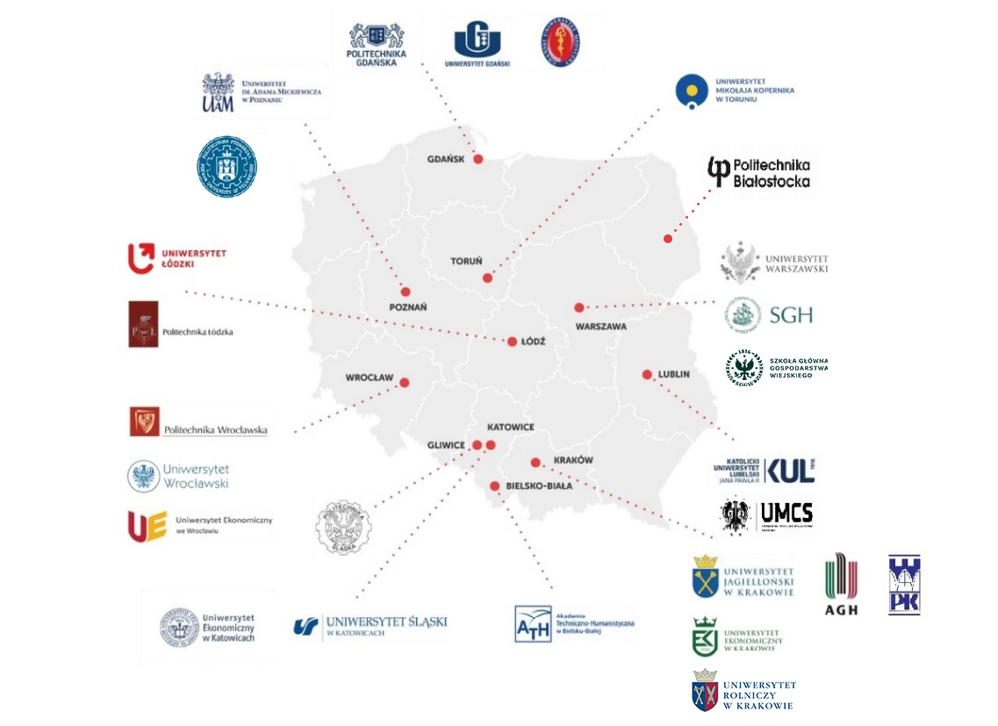
31 Member
universities

Slide 6
Who we cooperate with?
ESN/ KRD

Slide 7
Ewa Kiszka, MUG
Marta Foryś, AGH
Edyta Gałecka, UEK
Katarzyna Kacperczyk, SGH
Izabela Zawiska, UJ
Hanna Lamers, była ATH BB
President &
Steering Comittee
2023-2024

Slide 8
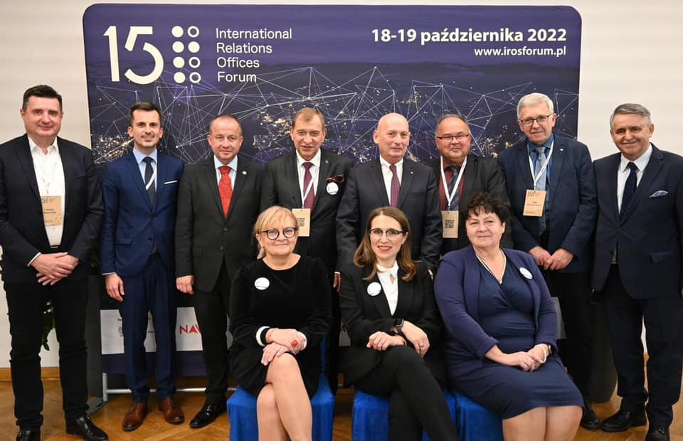
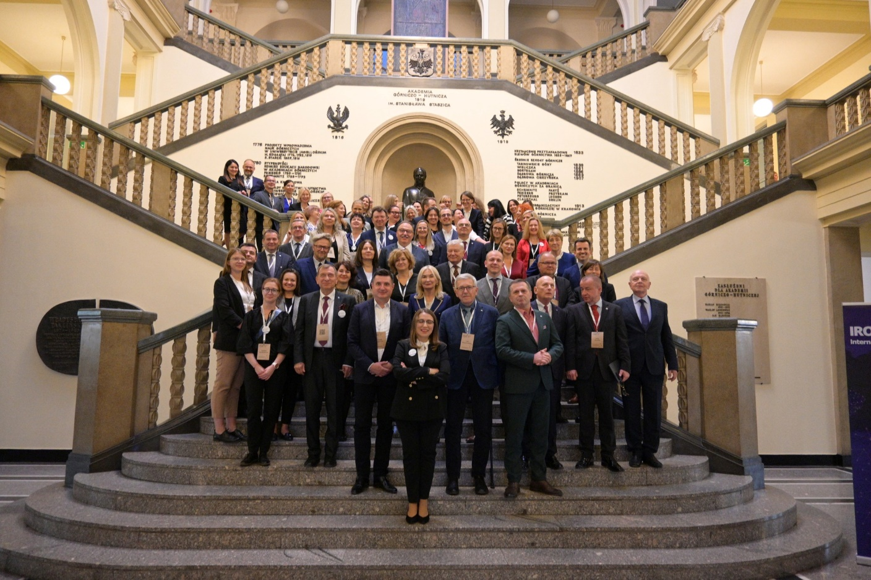
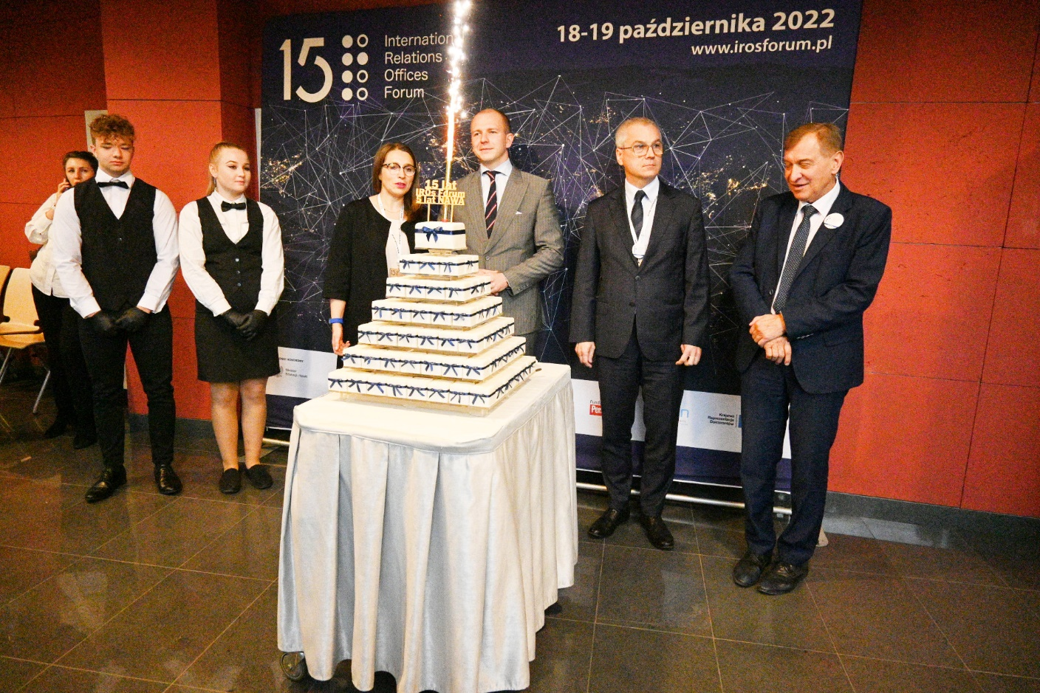
15 years of IROs Forum
Conference 18-19.10.2022 r.

Slide 9
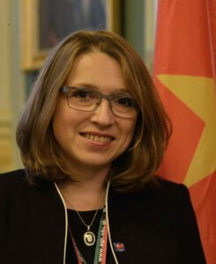
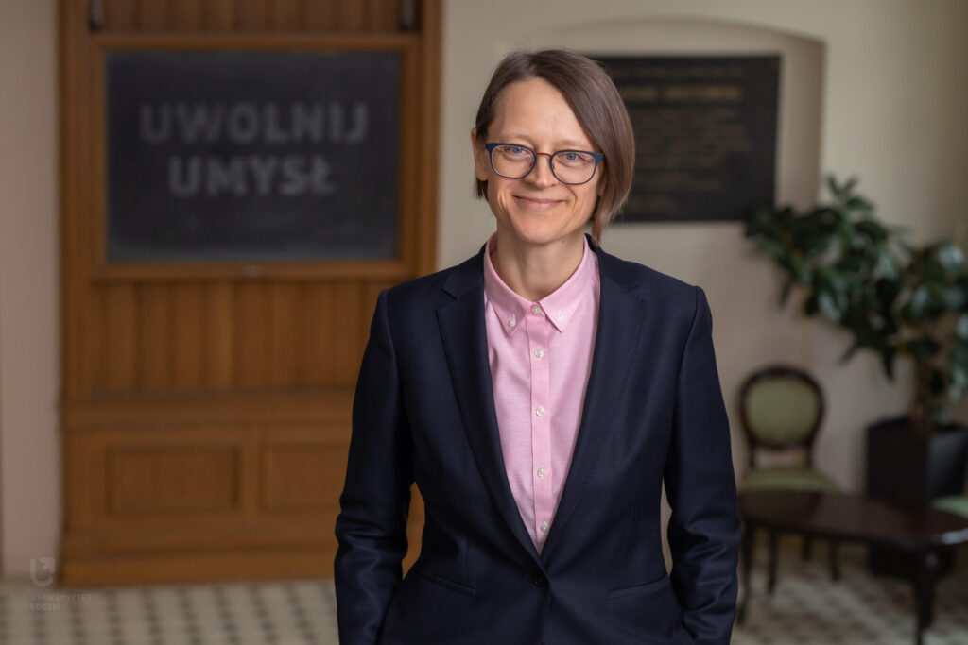
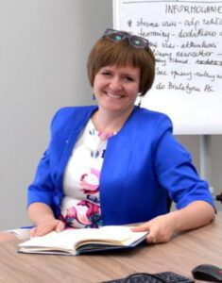
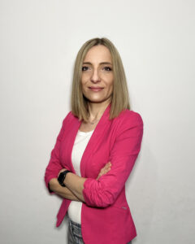
Expert Groups
European Universities Group (EUI) Coordinator: Marta Foryś, Akademia Górniczo-Hutnicza w Krakowie
IROs Admission Group Coordinator: Liliana Lato, Uniwersytet Łódzki
Erasmus+ Group Coordinator: Edyta Gałecka, Uniwersytet Ekonomiczny w Katowicach
IROs Forum discussion group: Good practices in doctoral schools Coordinator: Marta Gurczyńska, Politechnika Gdańska

Slide 10
IROS Experts Marta Foryś – Akademia Górniczo-Hutnicza w Krakowie Ewa Kiszka – Gdański Uniwersytet Medyczny Hanna Lamers – Akademia Techniczno – Humanistyczna w Bielsku Białej Liliana Lato – Uniwersytet Łódzki Ewa Mroczek – Politechnika Wrocławska Olga Pliczyńska – Mokijewska – UMCS Sylwia Rutkowska – Uniwersytet Ekonomiczny w Krakowie

Slide 11
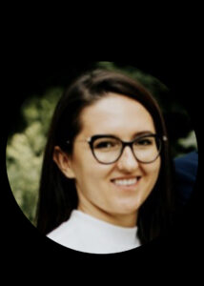
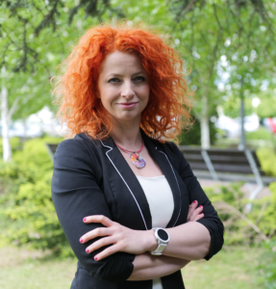
Coffee with IROsF/IROsF Guest
Coordinators:
Katarzyna Specjalska,
Szkoła Główna Gospodarstwa Wiejskiego
Magdalena Zawirska-Wolniewicz, Politechnika Poznańska

Slide 12
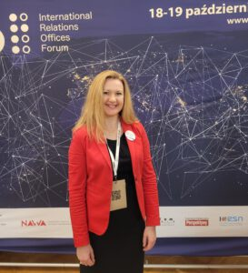
Support for applicants for admission to the Network
Coordinator:
Katarzyna Baron-Lisiakiewicz, Politechnika Krakowska

Slide 13
Organizational matters.
Current communication (website, Facebook, emails, surveys).
Meetings: IROsF Council (4 times a year), Steering Committee (once every 2 months), expert groups (according to coordinators' calendar), with activity coordinators (as needed) - online.
Acceptance of new members into the Network (presentation during IROsF Council meetings).
In-person meeting - proposal for this year, Gdańsk in autumn or spring of 2024.

Slide 14
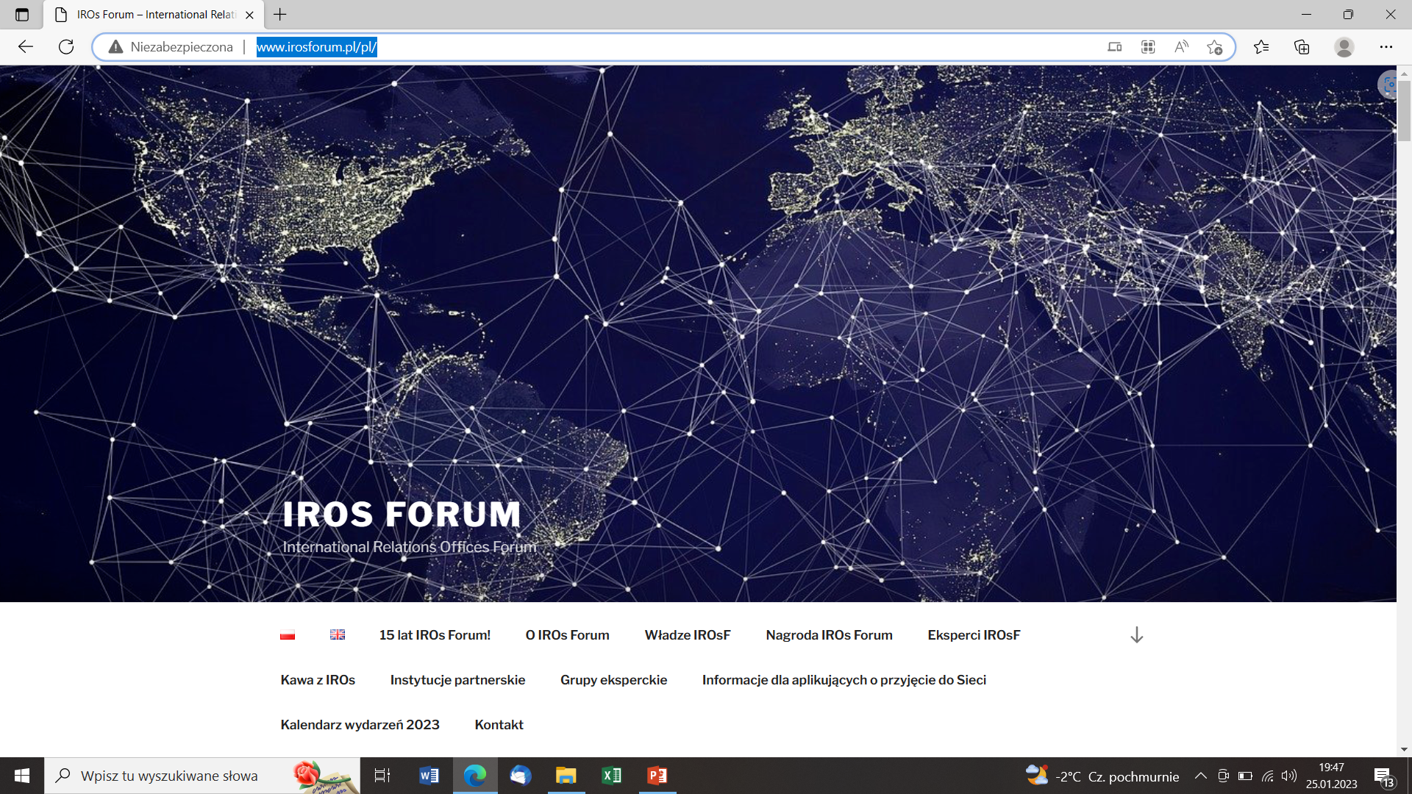
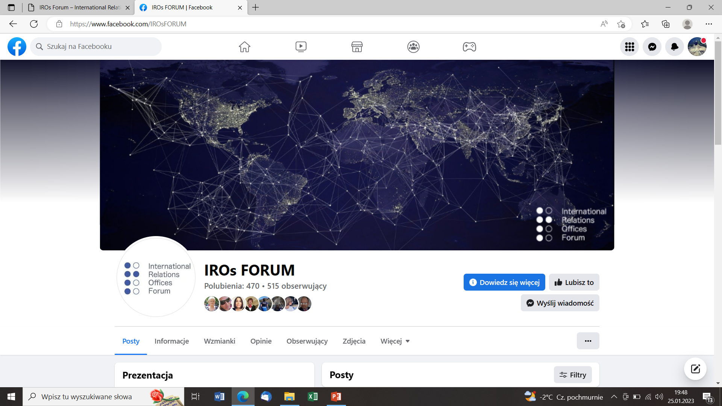
Our media
Website: IROs Forum – International Relations Offices Forum
FB profile
Our personal profiles on LinkedIn and Insta

Slide 15
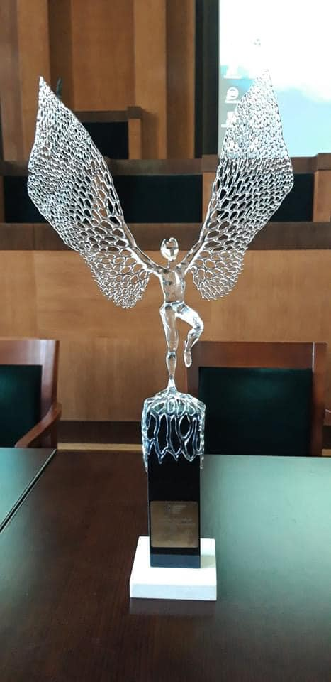
The IROs Forum Barbara Centkowska Award
The Barbara Centkowska Award is named after the long-time Director of the Office of Programs and International Cooperation at the University of Economics in Katowice, the co-founder and the first Chair of our network.
The award is given for an outstanding contribution to the internationalization at Polish universities, innovation, vision, best practices or special merits for the development of the IROs Forum. The award consists of a statuette and a diploma.
The IROs Forum Barbara Centkowska Award:
prof. Jerzy Buzek
Agata Kulesza
Katarzyna Aleksy
Dominika Janik Hornik
prof. Jan Wojtyła
dr Paweł Jessa
prof. Michał Seweryński
Beata Skibińska

Slide 16
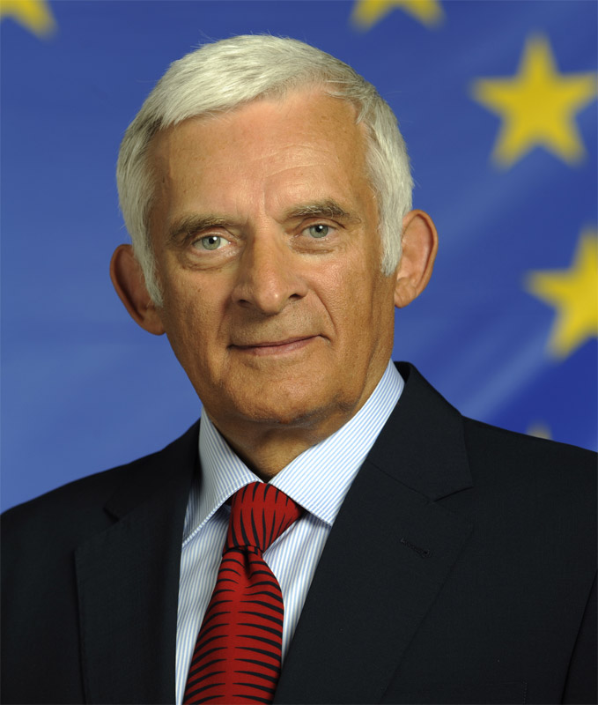
The IROs Forum Barbara Centkowska Award
prof. Jerzy Buzek: a politician, engineer and professor of technical sciences. He was a Polish Prime Minister from 1997 to 2001 and a President of the European Parliament from 2009 to 2012. He was also awarded with the Order of the White Eagle.

Slide 17
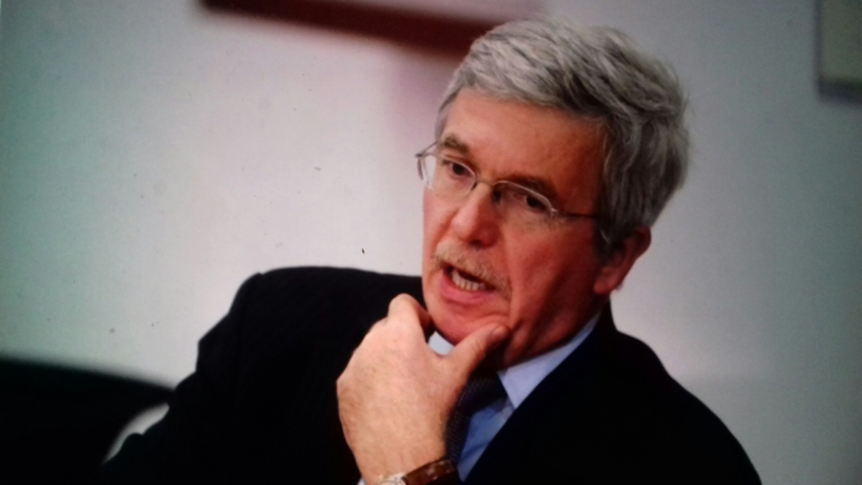
The IROs Forum Barbara Centkowska Award
Ambasador Jan Truszczyński
A lecturer at the Vistula Academy of Finance and Business and at the Polish Institute of Diplomacy.
He was an Ambassador of the Republic of Poland to the European Union and the government's plenipotentiary for negotiations regarding Poland's membership in the European Union.
In 2005, he was awarded the Legion of Honour Knight order for his efforts in favor of the European Union and the development of the French-Polish relations. In the same year, he was also honored with the Commander's Cross of the Order of Polonia Restituta.
From 2007 to 2014, he held management positions within the European Commission.

Slide 18
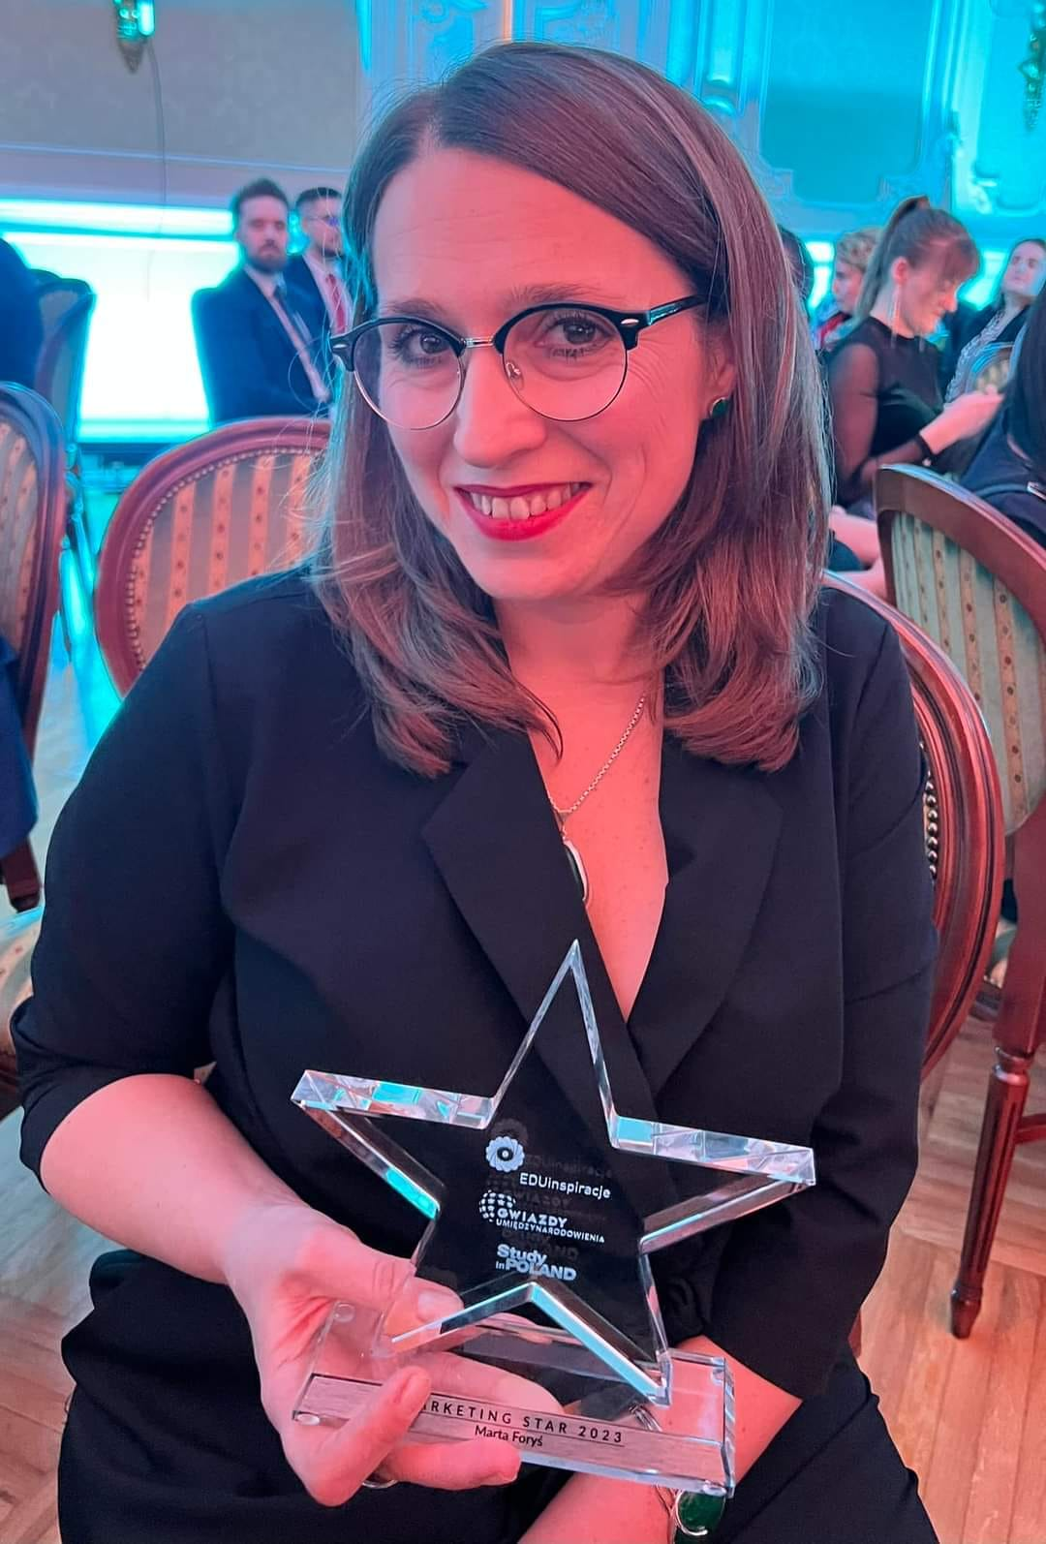
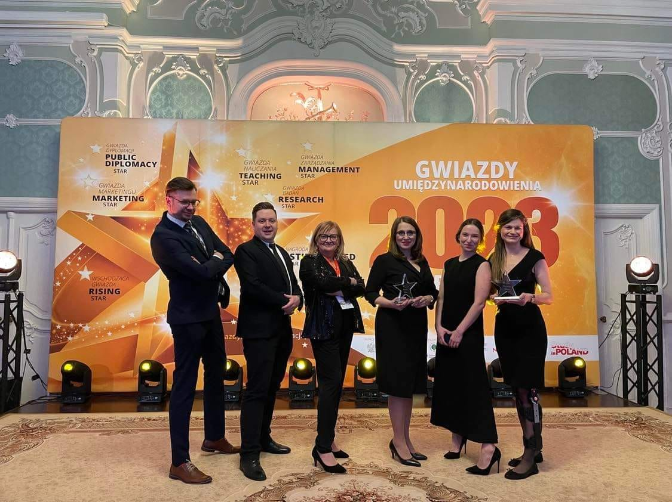
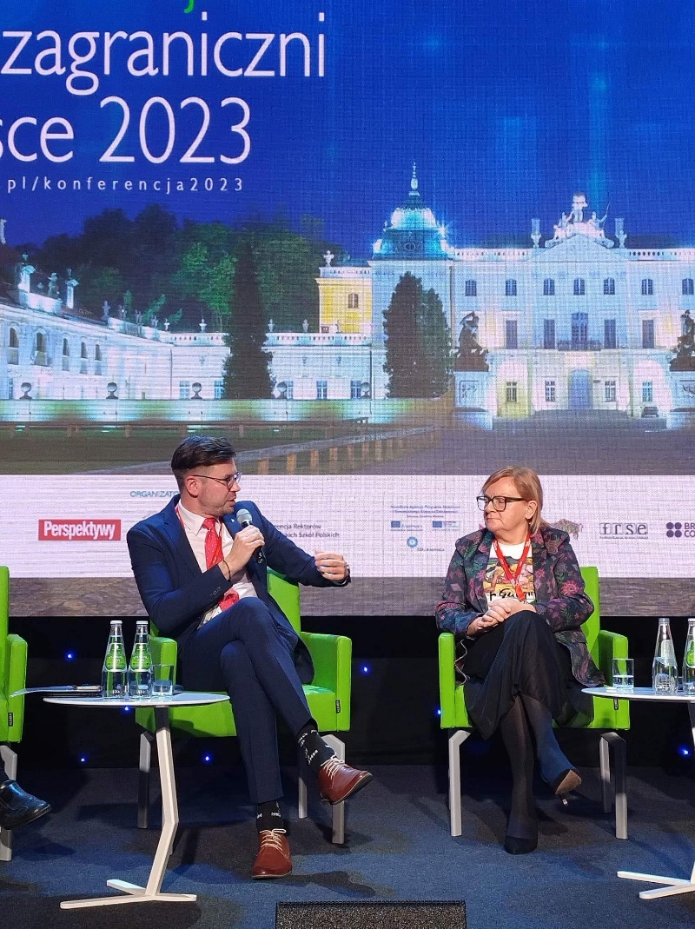
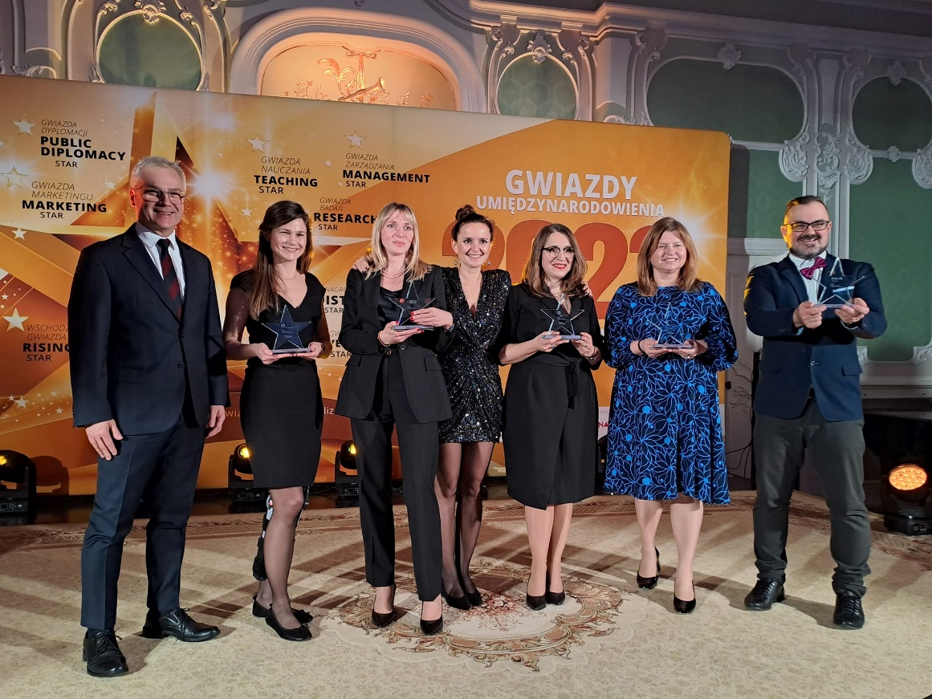
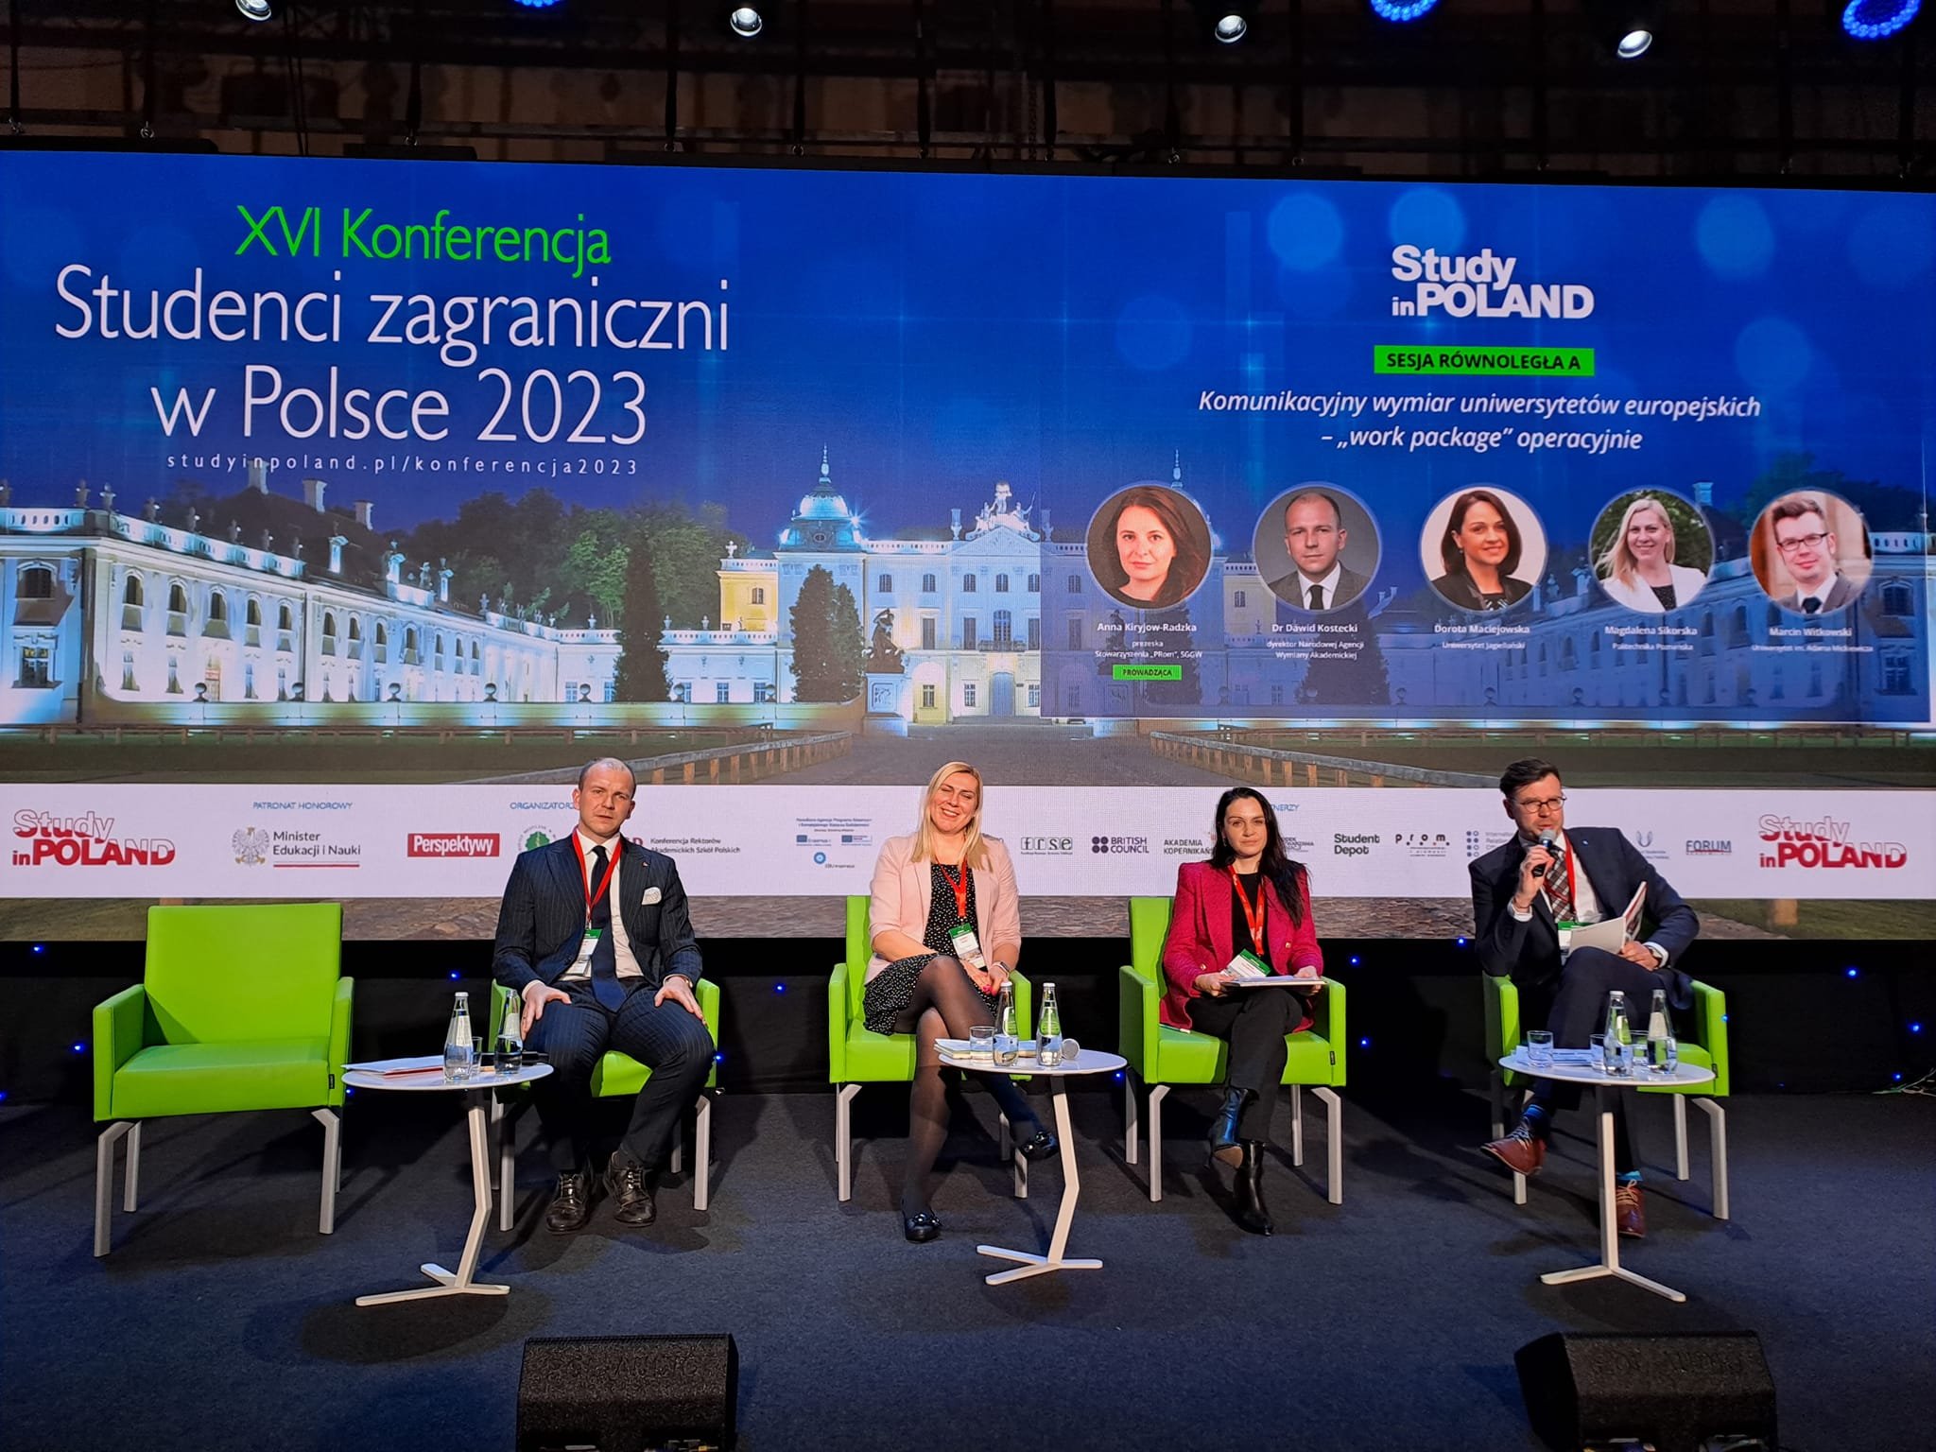
Conference/New Stars of Internationalization

Slide 19
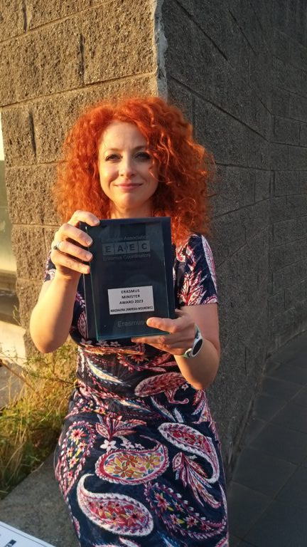
Stars of Internationalization
28 Stars in various categories from our Member Universities in the years 2018-2023
Stars of Internationalization IROsF – IROs Forum
The latest Star is Magdalena Zawirska-Wolniewicz, honored with the "Erasmus Minister 2023" award by the European Association of Erasmus Coordinators for her long-standing work and contributions to the Erasmus+ program.

Slide 20
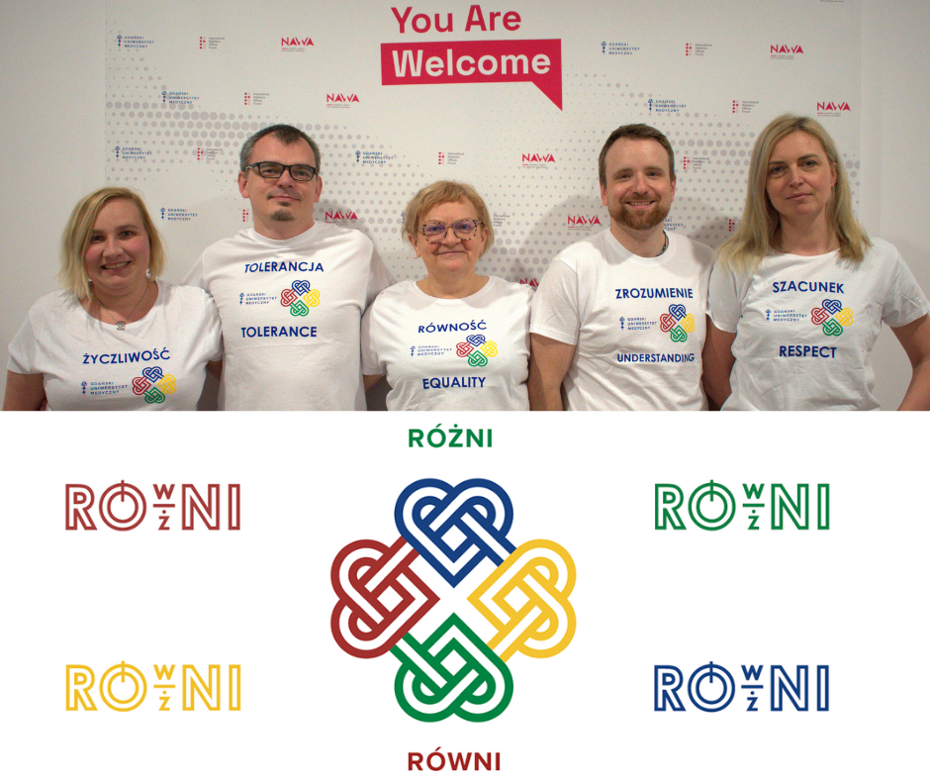
You are in good hands!
You can count on us ☺
Internationalization Office team:
Adrian Bakun – website supervisor, secretary
Karolina Derda – graphic design, managing FB profile
Dawid Spychała – support of the Boss ;) and events (Head of the International Cooperation Department)
Marzena Kołtoniak & Emilia Wiśniewska –Welcome Point Experts
Jacek Kaczmarek – Alumni relations Expert
Contact: iros@gumed.edu.pl

Slide 21
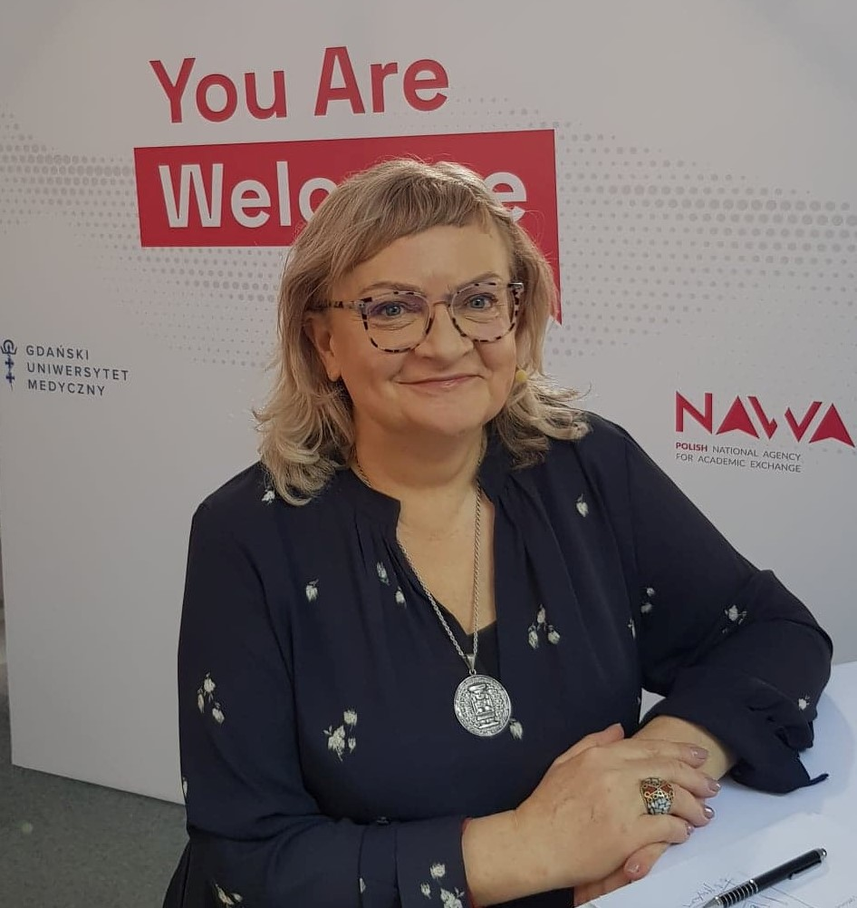
Ewa Kiszka
Head of the Internationalization Office
Medical University of Gdańsk.
Chair of IROs Forum for the term 2023-2024.
Contact:
ekiszka@gumed.edu.pl

